Slide 1

How to install CH340 driver
Yahboom
Yahboom OMIBOX Tutorial

Slide 2

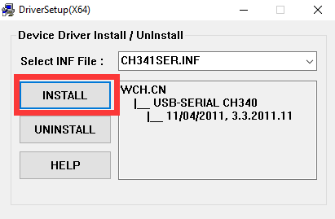
1.Enter to the Uart drive (CH340) folder we provided, you will see CH341SER.EXE. Double clicking on this application will bring up the interface as shown below, we need to click 【INSTALL】.
Yahboom OMIBOX Tutorial

Slide 3
2.We need to wait patiently until the screen of the driver installation is successful, indicating that the installation is complete, we need to click [OK].
Yahboom OMIBOX Tutorial

Slide 4
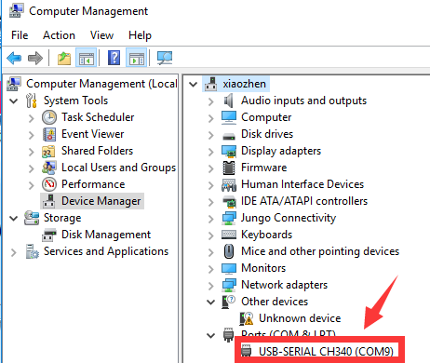
3. Connect the OmiBox robot to the computer with the USB cable and power up the OmiBox robot. Then open the computer device manager and you will recognize the corresponding CH340 port, as shown below:
Note: The port number of each computer will be different, as long as it recognizes that CH340 is the port we need.
Yahboom OMIBOX Tutorial

Slide 5
Inspire Creativity Embrace Innovation
Thank you!!!
Yahboom

